Slide 1
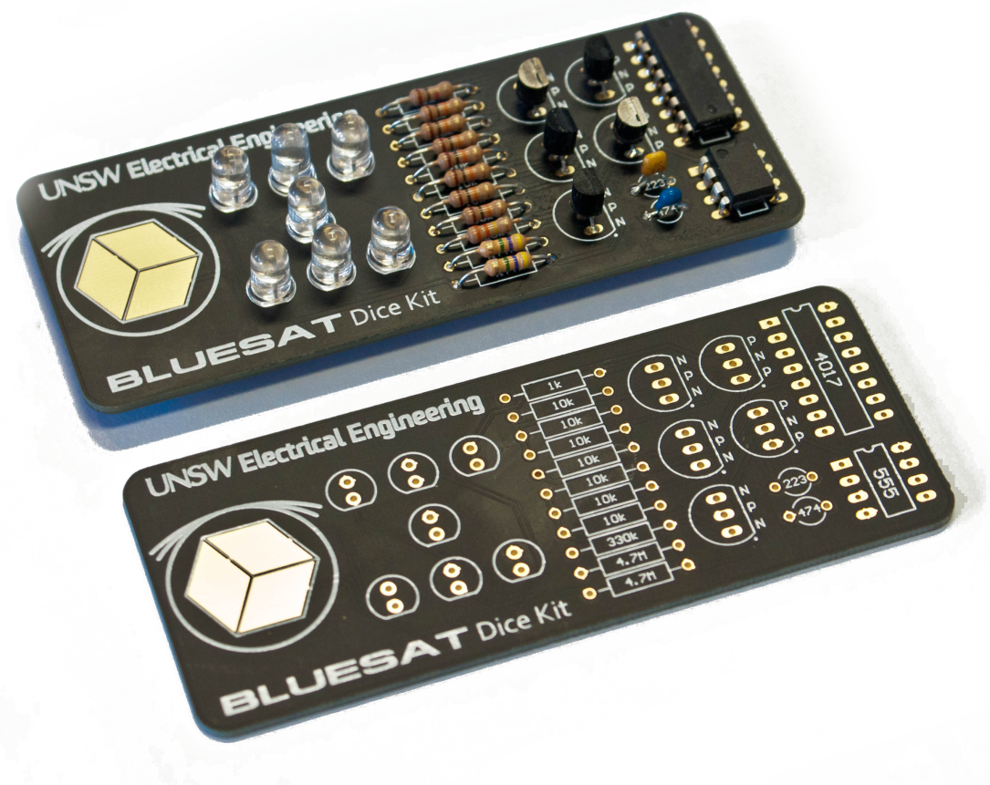
BLUESAT Dice Kit FREE Soldering Workshop
MUST wear enclosed shoes!
No Thongs
> No experience needed. <
Build an electronic dice kit and take it home!
Tomorrow (Friday 24th) 10am, 11am, 1pm. Register outside!

